Slide 1
CT super-resolution using
deep Convolutional Neural Network

Slide 2
Abstract
Data : training – 52set, test – 13set
Validation : 5-fold cross-validation
Experiment for resolution, contrast, noise properties
Improvement :
deblurring of boundaries of bone structures and air cavities
10% higher peak SNR, lower normalized root mean square than input
Output noise level : lower than ground truth, equivalent to iterative reconstruction result

Slide 3
Introduction
CT : immense amount of acquired data -> longer scan range & slower operating speed
Using small angle views with a thicker slice thickness -> recon
Reconstructed slice thickness ↓
Z-axis resolution ↑
Noise ↑
Dose ↑
Without dose ↑ , noise ↑ , enhance CT img resolution (similar to using thin slice)
CNN : good at super-resolution, de-noising
CNN base super-resolution approach -> some drawbacks in biomedical image processing
Network run for each patch -> redundancy -> slow computation
Trade off between localization accuracy and use of context
Large patch : use large context but max pooling ↑ -> localization accuracy ↓
Small patch : use little context -> localization accuracy ↑

Slide 4
Introduction
U-Net : provide end to end mapping architecture
Contracting path : capture the context
Expanding path : precise localization with large receptive field
Main purpose : CNN is also useful for CT image super-resolution
end-to-end mapping between low and high resolution imgs using modified U-Net
Performance : resolution↑, contrast↑ & noise↓

Slide 5
Materials and methods
Data : 65 clinical PET/CT studies for brain with suspected Parkinson’s disease
CT : 512 X 512 X (60 - 80)
Training dataset : 5 slices of a 3mm thickness -> averaged into 1 slice of 15mm thickness / 52 patients
Ground truth : middle slice of five slices (high resolution) / 13 patients
5 – fold cross-validation
Input : thick slice(low resolution) /Output : thin slice(high resolution)
2D slice
Total number of slice for training : 7670

Slide 6
Materials and methods
Network architecture
end to end mapping between thinner and thicker slice images
Architecture : contracting path & expanding path (symmetrical, each path : 5 sequential layer)
Contracting path : capture the context
Typical CNN architecture
Each layer : two [conv(3X3) → BN → ReLU] => max pooling(2X2, s = 2)
mini-batch size : size of six images
Expanding path : enable precise localization
Each layer : up-sampling(s = 2) => two[conv(3X3) → BN → ReLU]
Last layer : 1X1 conv for scaling
Skip connection between conv layer and deconv layer
Propagate context information to higher resolution layer

Slide 7
Materials and methods
Each conv
: conv -> BN -> ReLU
Conv
3X3
Same
s=1
f=32
Conv
3X3
Same
s=1
f=32
max
2X2
valid
s=2
Layer 1
512X512X1
512X512X32
512X512X32
256X256X32
Conv
3X3
Same
s=1
f=64
Conv
3X3
Same
s=1
f=64
max
2X2
valid
s=2
Layer 2
256X256X64
256X256X64
128X128X64
Conv
3X3
Same
s=1
f=128
Conv
3X3
Same
s=1
f=128
max
2X2
valid
s=2
Layer 3
128X128X128
128X128X128
64X64X128
Conv
3X3
Same
s=1
f=256
Conv
3X3
Same
s=1
f=256
max
2X2
valid
s=2
Layer 4
64X64X256
64X64X256
32X32X256
Conv
3X3
Same
s=1
f=512
Conv
3X3
Same
s=1
f=512
Layer 5
32X32X512
32X32X512

Slide 8
Materials and methods
Each conv
: conv -> BN -> ReLU
upconv
2X2
s=2
64X64X256
Conv
3X3
Same
s=1
f=256
Conv
3X3
Same
s=1
f=256
L4
Layer 6
64X64X256
32X32X512
64X64X256
64X64X256
64X64X512
skip connection from layer 4
upconv
2X2
s=2
128X128X128
Conv
3X3
Same
s=1
f=128
Conv
3X3
Same
s=1
f=128
L3
Layer 7
128X128X128
128X128X128
128X128X128
128X128X256
skip connection from layer 3
upconv
2X2
s=2
256X256X64
Conv
3X3
Same
s=1
f=64
Conv
3X3
Same
s=1
f=64
L2
Layer 8
256X256X64
256X256X64
256X256X64
256X256X128
skip connection from layer 2
# Channel ↓
Layer 9
512X512X32
upconv
2X2
s=2
Conv
3X3
Same
s=1
f=32
Conv
3X3
Same
s=1
f=32
Conv
1X1
Same
s=1
f=32
L1
512X512X32
512X512X32
512X512X32
512X512X1
512X512X64
skip connection from layer 1

Slide 9
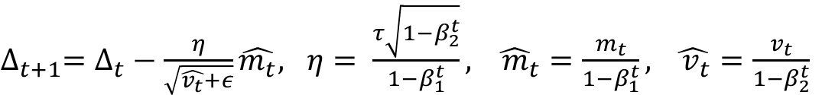
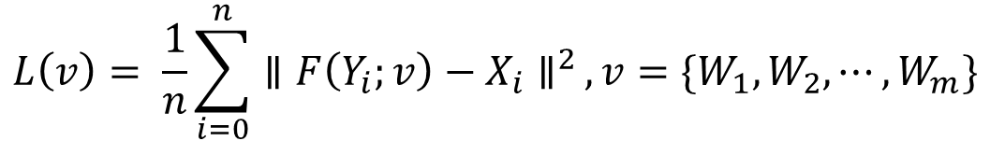

Data training and loss function
Weight : truncated normal distribution
Loss function : L2 Loss
F(Yi) : reconstructed image from low-resolution image Yi
Xi : high resolution label image
Activation function : ReLU
Optimizer : Adam
Epoch : 18
$$L\left(v\right)= \frac{1}{n}\sum_{i=0}^{n}{{∥F\left(Y_{i};v\right)−X_{i}∥}^{2}}, v=\{W_{1}, W_{2},⋯,W_{m}\}$$
n : #imgs in mini-batch
m : #layer
t : iteration number
$∆_{t}$ : update parameter(weight/bias)
τ : learning rate
$m_{t}$, $v_{t}$ : moment vector (initialized to zero)
$β_{1}$ : 0.9 $β_{2}$ : 0.999 $ε$ : ${10}^{−8}$
$∆_{t+1}=∆_{t}−\frac{η}{\sqrt{\hat{v_{t}}+ε}}\hat{m_{t}}, η= \frac{τ\sqrt{1−β_{2}^{t}}}{1−β_{1}^{t}}, \hat{{ m}_{t}}=\frac{m_{t}}{1−β_{1}^{t}}, \hat{{ v}_{t}}=\frac{v_{t}}{1−β_{2}^{t}}$

Slide 10
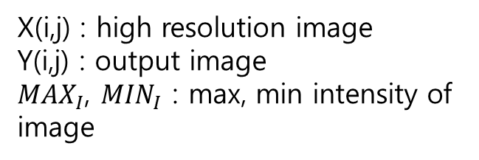
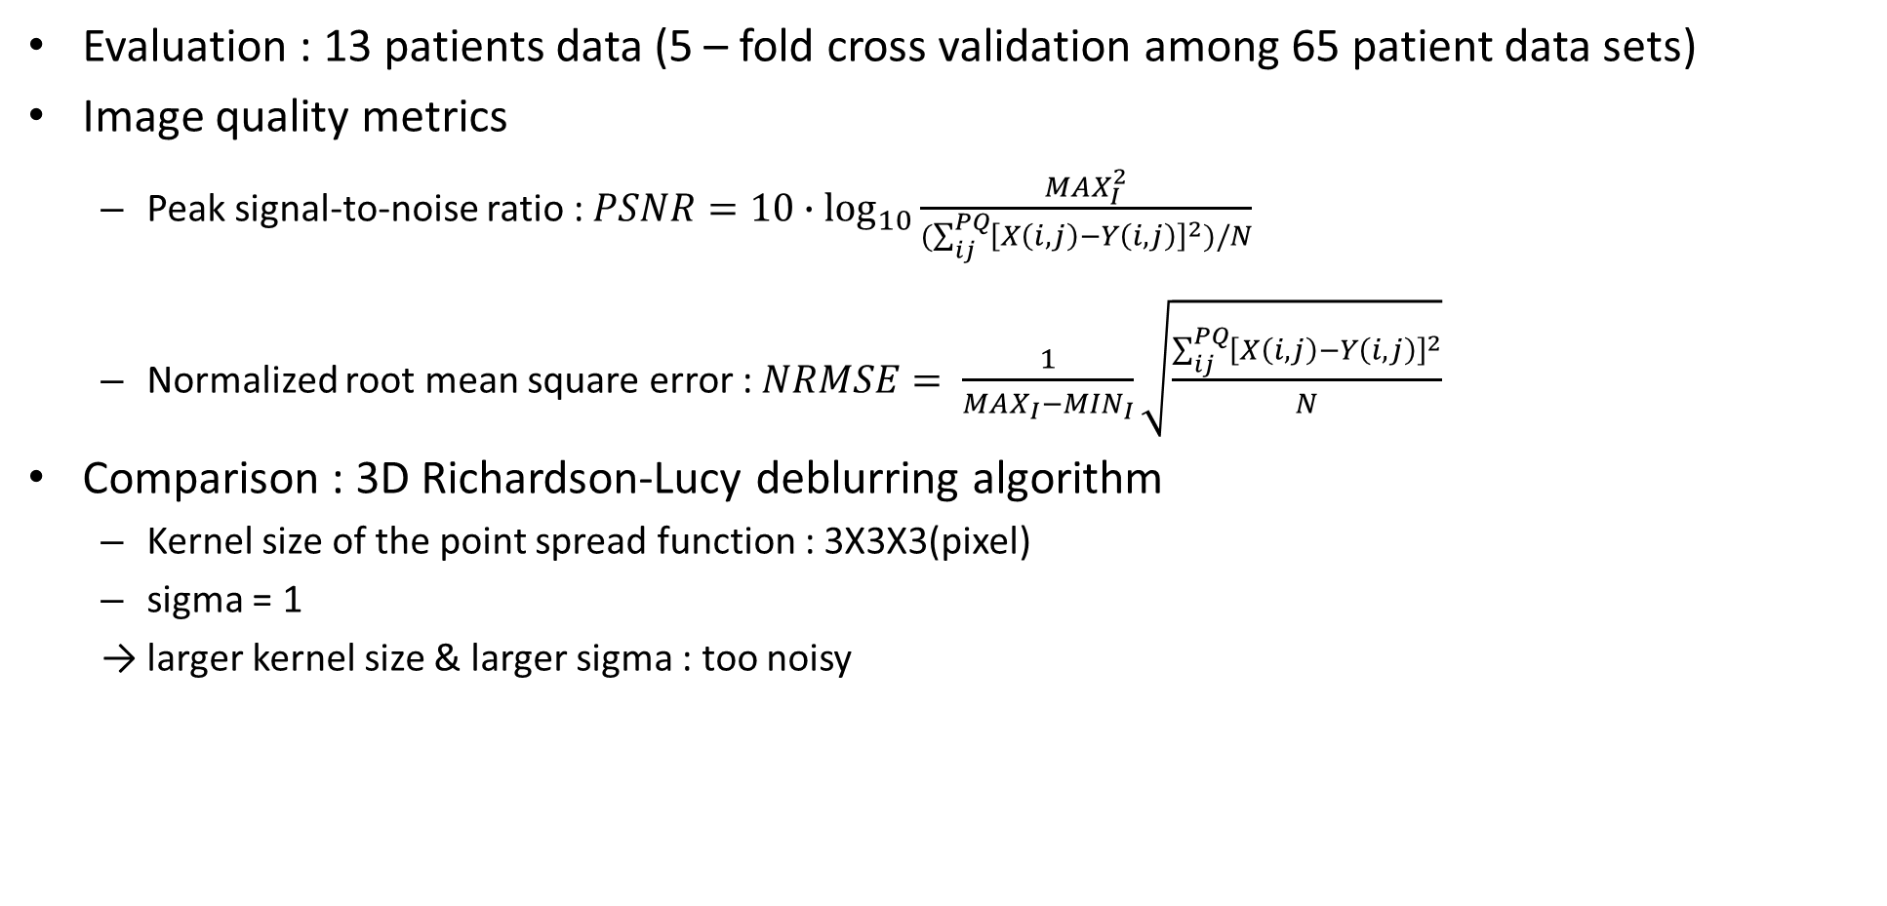
Image analysis
Evaluation : 13 patients data (5 – fold cross validation among 65 patient data sets)
Image quality metrics
Peak signal-to-noise ratio : $PSNR=10∙\log_{10}{\frac{{MAX}_{I}^{2}}{(\sum_{ij}^{PQ}{{\left[X\left(i,j\right)−Y\left(i,j\right)\right]}^{2}})/N}}$
Normalized root mean square error : $NRMSE= \frac{1}{{MAX}_{I}−{MIN}_{I}}\sqrt{\frac{\sum_{ij}^{PQ}{{\left[X\left(i,j\right)−Y\left(i,j\right)\right]}^{2}}}{N}}$
Comparison : 3D Richardson-Lucy deblurring algorithm
Kernel size of the point spread function : 3X3X3(pixel)
sigma = 1
→ larger kernel size & larger sigma : too noisy
X(i,j) : high resolution image
Y(i,j) : output image
${MAX}_{I}$, ${MIN}_{I}$ : max, min intensity of image
Highest PSNR, lowest NRMSE
(kernel size from 0.5 to 3.0 in step of 0.5)

Slide 11
Image analysis
Compare PSNR, NRMSE of original input / RL deblurred input / network output
ROI based SD compare to assess the noise characteristics of soft tissue
Additional verification for clinical practice : recover 1mm slice from 5mm slice
Data : training - 56 patients(9302 slices) / test – 14 patients(2338 slices)
CT : 512 X 512 X (180-200)
Verification : ROI based SD comparison & 5 – fold cross-validation

Slide 12
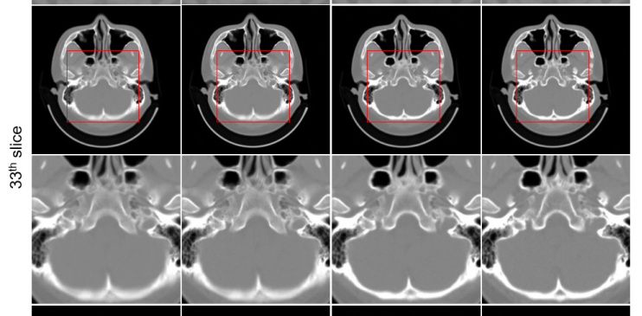
Results
Recovery from 3mm slice from 15mm slices
1) image
Remarkable improvement : Deblurring of boundaries of bone structures and air cavities
Computation time : 30ms per slice
Input(15mm)
RL deblurring
CNN output
Ground truth

Slide 13
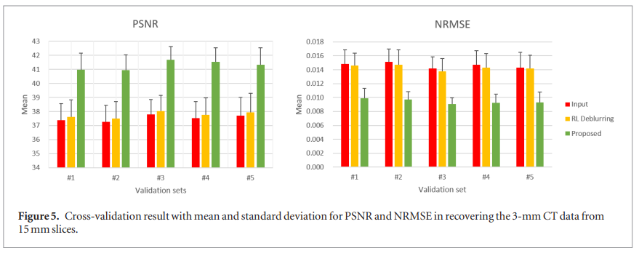
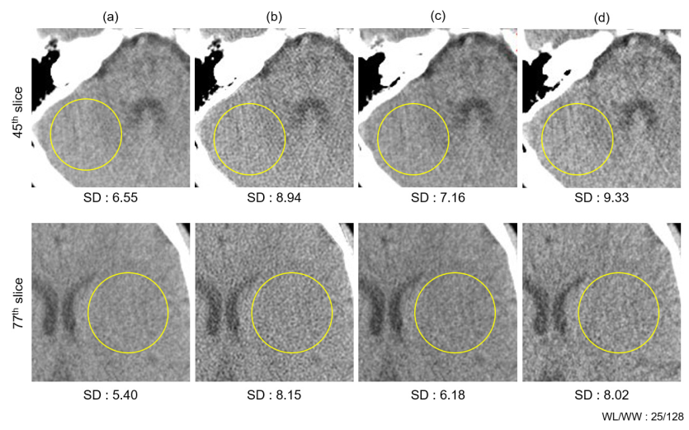
Results
2) Quantitative analysis of PSNR, NRMSE
40% higer PSNR, lower NRMSE than input(thicker slice)
3) ROI based standard deviation
RL deblurring increase noise level

Slide 14
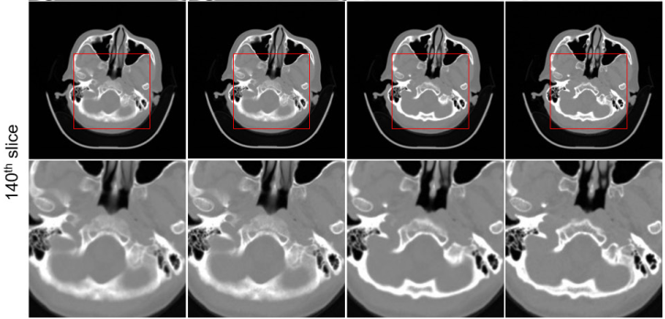
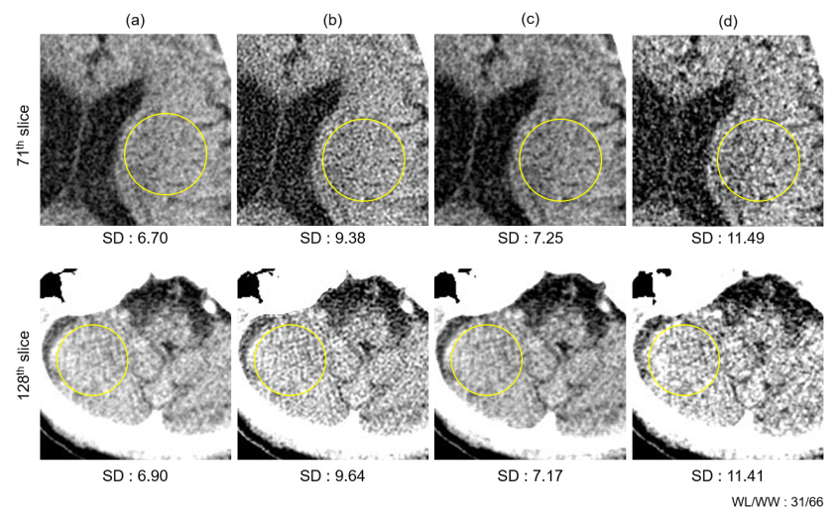
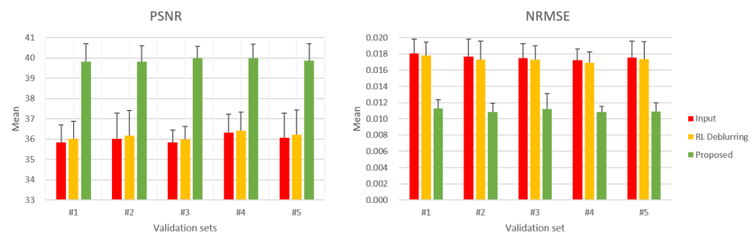
Results
Recovery from 1mm slice from 5mm slices
Image 3) ROI based standard deviation
PSNR & NRMSE
Input(15mm)
RL deblurring
CNN output
Ground truth

Slide 15
Discussion
Show the potential of deep-learning based super-resolution of x-ray CT images
Thick CT image : higher SNR (higher number of x-ray quanta per voxel)
→ CNN generated output : indistinguishable from ground truth
Not analyze the impact of super-resolution on lesion detectability
Useful for previewing CT image reconstruction
Thick CT slice : low soft-tissue contrast, high noise level
Reduce artifacts(insufficient angular sampling)
Limitation
The proposed method use 2D CNN
CNN super-resolution : expect to reproduce small structure

Slide 16
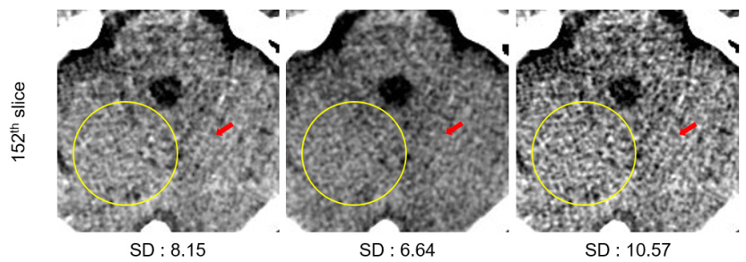
Discussion
Spatial resolution of CT image : determined by the size of detector elements
Development of new detector : time intensive, high cost
Smaller detector element : increase noise
sharpening (HPF) / deblurring (Laplacian filter / Richardson-Lucy algorithm) → noise↑, not as effective as proposed method
Focus on image resolution and contrast recovery in the degraded images
→ proposed method : kind of deconvolution operation for axial spatial resolution recovery
CNN based super resolution technique : improve medical image quality & reduce scan time
Noise reduction in CT : important for reducing radiation dose & improving diagnostic power
→ proposed method : effective in noise reduction
SAFIRE
Proposed method
Ground truth

